Slide 1
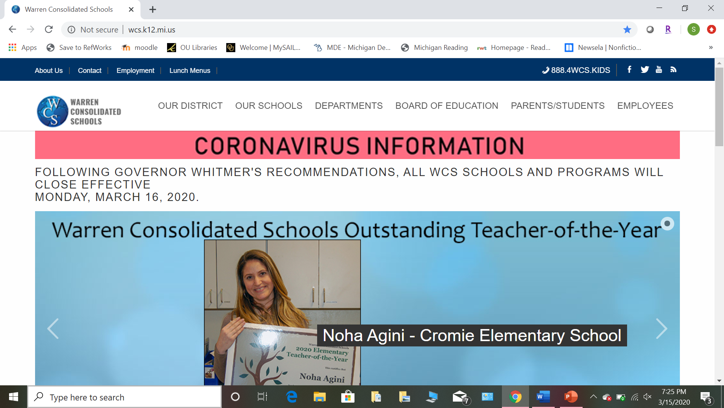
Go to https://www.wcs.k12.mi.us/

Slide 2
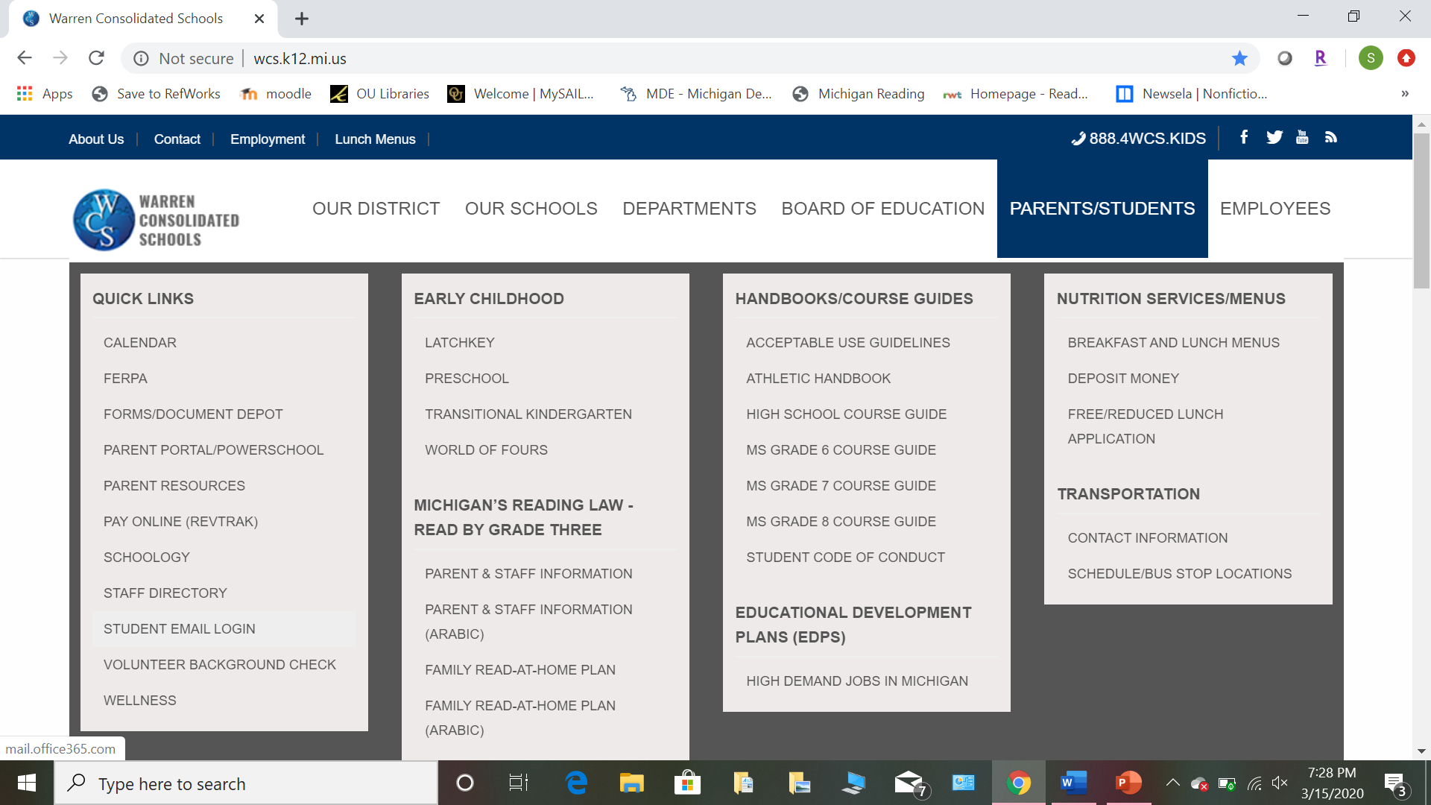
Hover over “Parents/Students” and click “Student Email Login”

Slide 3
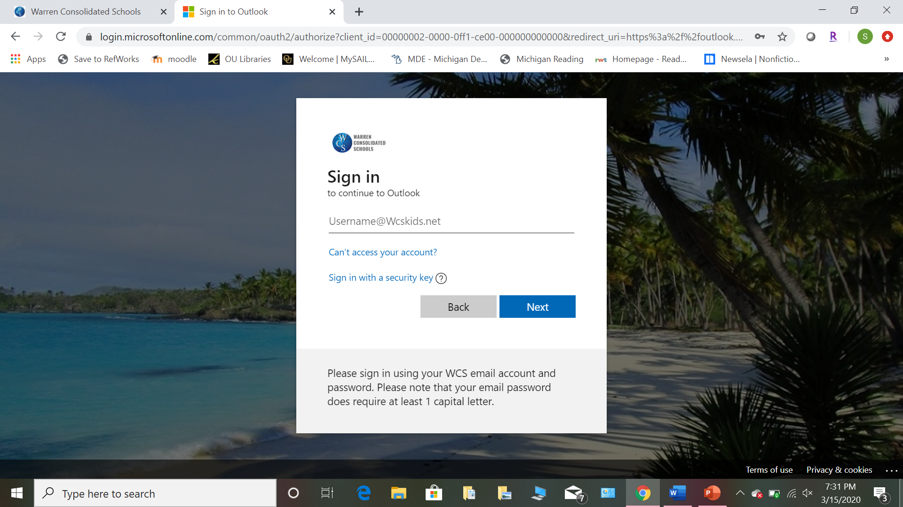
Your student ID is your username. You must include @wcskids.net when logging in. Your password is what you use to log into school computers

Slide 4
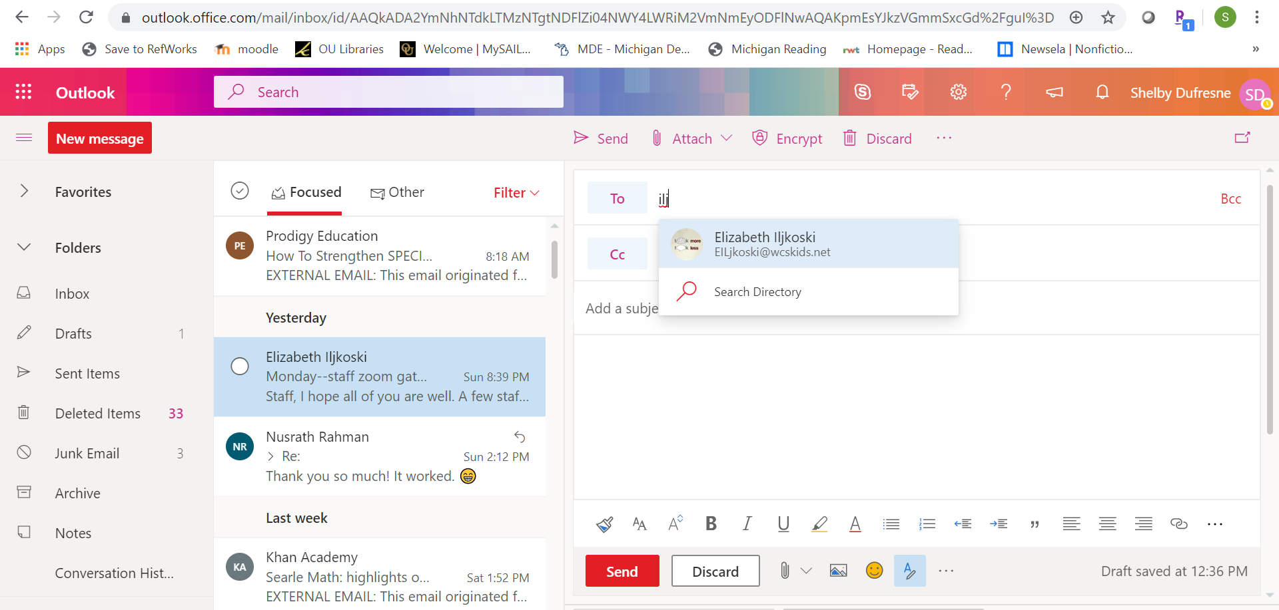
If you need to email your teacher select “New Message” and start typing their name in the “To” bar. You can find the emails of all your teachers this way- by typing in their last names.

